Slide 1

Anomaly Detection Practical – Challenge II
Hamza Tahir & Muhammad Hamza Usmani
Technische Universität München
Fakultät für Informatik
22nd November, 2016

Slide 2
The Challenge
Machine Learning Task
To classify a hotel review as ‘fake’ (Y) or ‘not fake’ (N).
The Data
Hotel reviews from YELP. The reviews consisted of reviews from Illinois.
Set Type | Number of Samples | Classification
Training Set | 2696
Test Set | 2950 | N/A.
2319 N | 337 Y
Table 1: The Dataset

Slide 3
Behavioral Vs Linguistic Features
There are generally two kinds of features in classification of spam:
Linguistic Features
Behavioral Features
Linguistic Features
Focuses on content of reviews.
Break text in n-gram/shingle representation.
Measure of similarity among words - (Cosine distance).
Behavioral Features
Focuses on behavior of review/reviewer: Metadata
Requires feature mining.
Dependent on the dataset.

Slide 4
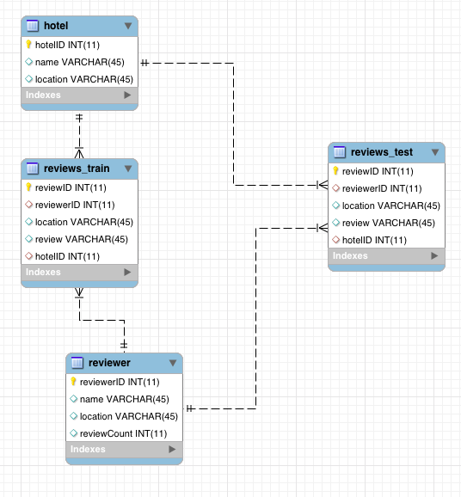
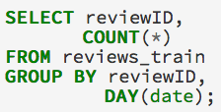
Methodology – Using a Database
Loaded dataset into a database
Used queries to change aggregation levels.
Find patterns and relations between features.
Eased our work.
Number of reviews per day
ERD

Slide 5
Problems:
Dataset was a nightmare to pre-process:
Semi-colons in the review content!
A simple pandas dataset import_csv could not be used with ‘ ; ‘ as a delimiter.
The data of 4 reviewers in the training set and 9 reviewers in test set is missing!
‘JOINS’ leave missing columns.
Solution: Manually correct the ‘test’ dataset at least.

Slide 6

Features
We used the following features for classification:
Maximum Number of Reviews (per day)*
Percentage of Positive Reviews*
Review Length*
Reviewer Deviation (absolute values)*
Review Metadata (rating, usefulCount, coolCount, funnyCount columns)
Reviewer Metadata (friendCount, firstCount, usefulCount, coolCount & funnyCount columns)
Normalizing Features
Normalized values between 0-1.
* Behavioral features taken from Mukherjee et al.

Slide 7
Features – Debunks
Max Number of Reviews Per Day:
CLAIM: Spammers have > 5 reviews per day.
DEBUNK: In our database, most reviewers only post once per day.
Review Length:
CLAIM: Fake reviews have greater length than genuine ones.
DEBUNK: In our dataset, average length of fake review = 122 < average length of genuine review = 157.
Percentage of Positive Reviews :
CLAIM: Spammers generally give a higher rating.
DEBUNK: In our dataset, average PPR of spammer = 0.52 < Average PPR of non-spammer = 0.62.

Slide 8
Features – VALIDATIONS
Reviewer Deviation:
CLAIM: Spammers deviate more than general opinion.
PROVED: In our database, spammer deviation = 0.52 > non-spammer deviation = 0.62.
Review Metadata:
CLAIM: Spam review ‘counts’ less than non-spam review counts.
PROVED: In our dataset, average ‘useful’ count for spam reviews = 0 and for non spam reviews = 1.107
Reviewer Metadata:
CLAIM: Spammers ‘counts’ less than non-spammers count
PROVED: In our dataset, average ‘useful’ count for spammers ~ 5 and for non spammers ~ 470

Slide 9
Techniques Used
0. Discovery: Supreme Classifier
1. Naive Bayes
2. Support Vector Classier (SVC)
3. Random Forest

Slide 10
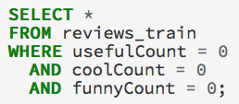
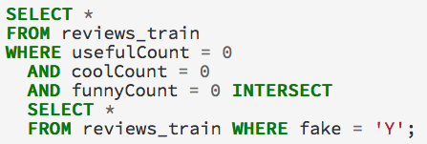
Supreme Classifier
The Classifier:
Returns all 377 rows
The Problem
1055 genuine reviews are classified as fake!
1055 out of 2696, misclassification rate of 39%
Don’t try this classifier at home!

Slide 11
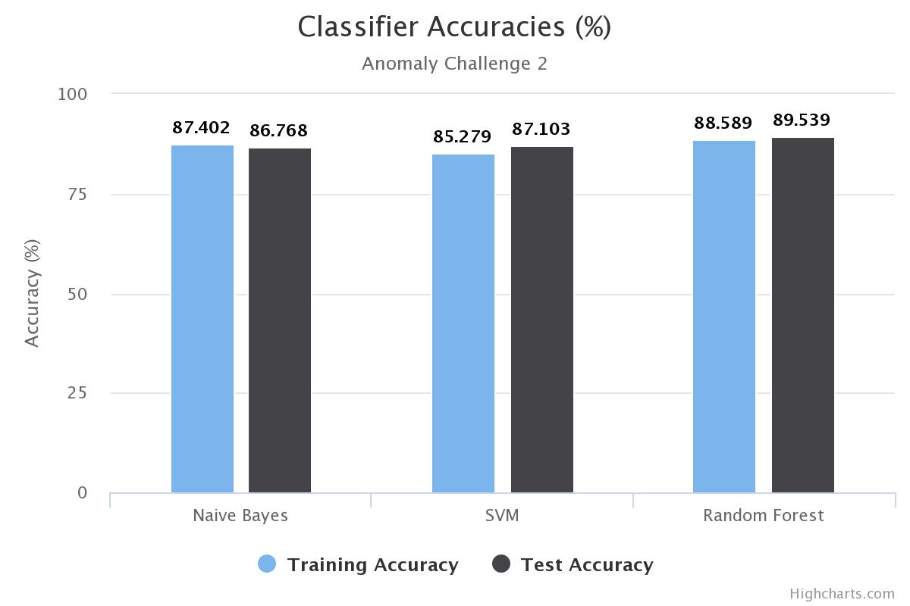

Slide 12
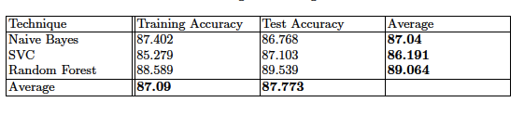
Results: Training & Test Error with 6-Cross Validation

Slide 13
What made the difference?
Started off with Training Accuracy of 86% but test accuracy of 50% accuracy!
This was due to problems within the data.
Fixing data errors and using all mentioned behavioral features raised test accuracy to 0.72201.
Using only ‘reviewer’ features raised test accuracy to 0.80681.
Random Under-sampling of non-spam reviews raised test accuracy to 0.85326.
Our training dataset is skewed: Only 10% fake reviews
Adding ‘review’ features raised test accuracy to 0.88943.

Slide 14
Thank you!

